Slide 1


Maven
SDET Fundamental Training

Slide 2

Introduction
Apache Maven is a software project management and comprehension tool.
Download: http://maven.apache.org/download.cgi
Super set of ANT
Maven can manage a project's build, reporting and documentation
Has own repository: http://search.maven.org/

Slide 3
Introduction
Based on the concept of a project object model
Maven can manage a project's build, reporting and documentation from a central piece of information.
All configuration is done in single file (pom.xml)

Slide 4
Maven LifeCycle
Validate
Generate Sources
Generate Resources
Compile
Test
Package
Install
Deploy

Slide 5
Installation & Configuration
Unzip the file
set/export the path for $>../../../bin
Optional: MAVEN_OPTS=-Xms256m -Xmx512m
Can also be used to set more parameters

Slide 6
Using Maven
To Know version: mvn –version
Maven has boiler plate for 1301 projects (depends on version)
By default maven will point to core java project

Slide 7
To Get All Projects
mvn archetype:generate
You can choose from over 1000+ readily available project

Slide 8
my-app
|-- pom.xml
`-- src
|-- main
| `-- java
| `-- com
| `-- mycompany
| `-- app
| `-- App.java
`-- test
`-- java
`-- com
`-- mycompany
`-- app
`-- AppTest.java

Slide 9
cd my-app
Look for pom.xml
mvn compile
mvn clean compile
mvn package
mvn clean package
mvn test
mvn clean test
mvn site – to generate documentation
mvn clean
mvn eclipse:eclipse – compatible to eclipse
Maven Commands

Slide 10
To Execute
java -cp target/my-app-1.0-SNAPSHOT.jar com.mycompany.app.App

Slide 11
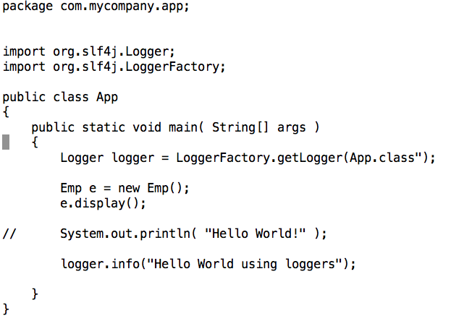
EXAMPLE Logging with Slf4j

Slide 12
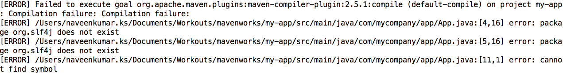
Compiling after Loggers
!

Slide 13
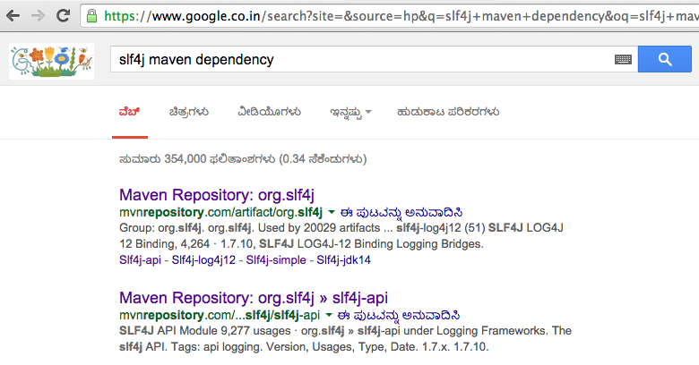
Change pom.xml One change to pom.xml will fix

Slide 14
Change pom.xml One change to pom.xml will fix
Open pom.xml in editor
Add below code (under dependencies)
<dependency>
<groupId>org.slf4j</groupId>
<artifactId>slf4j-api</artifactId>
<version>1.7.7</version>
</dependency>

Slide 15
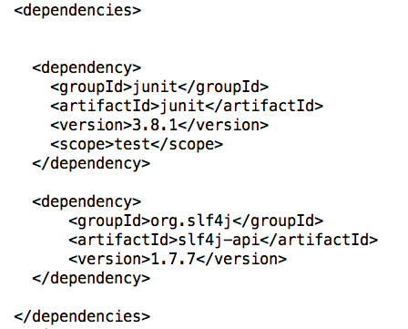

Change pom.xml One change to pom.xml will fix

Slide 16
Building a Web Application
mvn archetype:generate
Look for webapp-j2ee

Slide 17
Building a Web Application
Look for pom.xml
There are 3 scopes, by default is compile
<scope>scope</scope>
<scope>provided</scope>
<scope>compile</scope>

Slide 18
Building a Web Application
Plugins
<plugins>
<plugin>
<groupId>org.apache.maven.plugins</groupId>
<artifactId>maven-compiler-plugin</artifactId>
<version>2.0.2</version>
<configuration>
<source>1.4</source>
<target>1.4</target>
</configuration>
</plugin>
</plugins>
Note: Maven considers everything as plugin, including compiler

Slide 19
!
The previous pom.xml will not compile if you have generics used, since it was introduced in 1.5.
We can make changes in pom.xml, from 1.4 to 1.5
Or you can delete the plugin and try it should work since by default it would have taken jdk1.5+

Slide 20

Maven & Eclipse
Eclipse and Maven haveseamless integration together, we have two plugins in market Maven to Eclipse and Eclipse to Maven, most of the latest Eclipse has Maven, if you have old Eclipse then find it in market place.

